Slide 1
Neural Network Lecture Review
Paul An Wenya Chen Rui Wan

Slide 2
Architecture

Slide 3
Learning

Slide 4
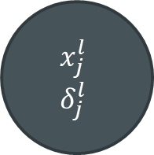

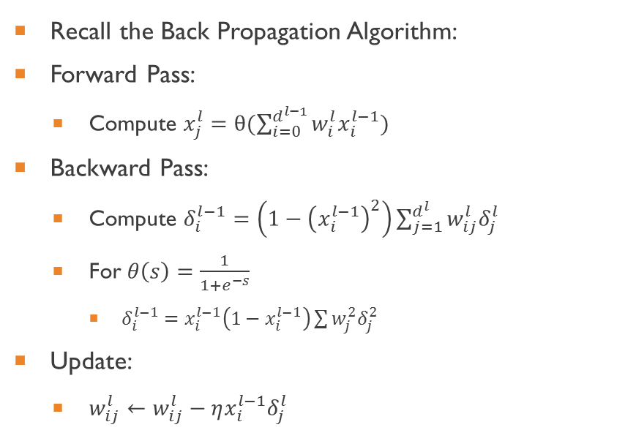



Example
Recall the Back Propagation Algorithm:
Forward Pass:
Compute $x_{j}^{l}=θ(\sum_{i=0}^{d^{l−1}}{w_{i}^{l}x_{i}^{l−1})}$
Backward Pass:
Compute $δ_{i}^{l−1}=\left(1−{\left(x_{i}^{l−1}\right)}^{2}\right)\sum_{j=1}^{d^{l}}{w_{ij}^{l}δ_{j}^{l}}$
For $θ\left(s\right)=\frac{1}{1+e^{−s}}$
$δ_{i}^{l−1}=x_{i}^{l−1}\left(1−x_{i}^{l−1}\right)\sum{w_{j}^{2}δ_{j}^{2}}$
Update:
$w_{ij}^{l}←w_{ij}^{l}−ηx_{i}^{l−1}δ_{j}^{l}$
$$w_{0}^{l}$$
$$x_{j}^{l}$$
$$δ_{j}^{l}$$
$$w_{1}^{l}$$
$$w_{0}^{l+1}$$
$$w_{2}^{l}$$

Slide 5
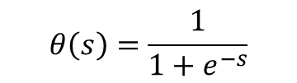

Example
$$θ\left(s\right)=\frac{1}{1+e^{−s}}$$
$w_{0}$ intercepts
.05
0.01
Example Input
Example Output
.10
0.99
Hidden Layer

Slide 6










Example: Initial Weights
$$w_{0}^{1}=.35$$
$$w_{0}^{2}=.60$$
.05
$$w_{1}^{1}=.15$$
$$w_{1}^{2}=.40$$
0.01
$$w_{2}^{1}=.25$$
$$w_{2}^{2}=.50$$
$$w_{3}^{1}=.20$$
$$w_{3}^{2}=.45$$
.10
0.99
$$w_{4}^{1}=.30$$
$$w_{4}^{2}=.55$$

Slide 7


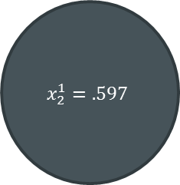


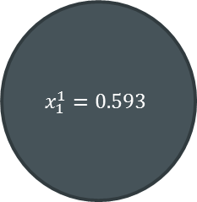


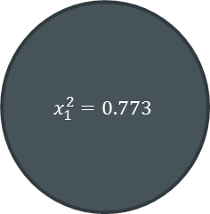


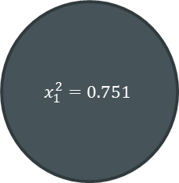


Example: Forward Pass
$$w_{0}^{1}=.35$$
$$w_{0}^{2}=.60$$
$$x_{1}^{1}=0.593$$
$$x_{1}^{2}=0.751$$
.05
$$w_{1}^{1}=.15$$
$$w_{1}^{2}=.40$$
0.01
$$w_{2}^{1}=.25$$
$$w_{2}^{2}=.50$$
$$x_{2}^{1}=.597$$
$$x_{1}^{2}=0.773$$
$$w_{3}^{1}=.20$$
$$w_{3}^{2}=.45$$
.10
0.99
$$w_{4}^{1}=.30$$
$$w_{4}^{2}=.55$$
$$θ\left(w_{0}^{1}+{w_{2}^{1}∗.05+w}_{4}^{1}∗.10\right)= θ(.35+ .01+.03)$$
$$θ\left(w_{0}^{2}+{w_{2}^{2}∗x_{1}^{1}+w}_{4}^{2}∗x_{2}^{1}\right)= θ(1.224558)$$

Slide 8
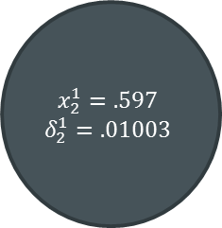
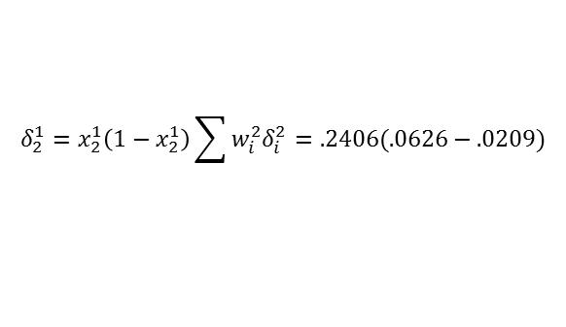
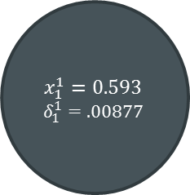

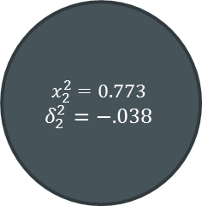
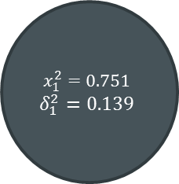
Example: Backward Pass
$$w_{0}^{1}=.35$$
$$w_{0}^{2}=.60$$
$$δ_{1}^{2}=−2∗\frac{1}{2}\left(0.01−x_{1}^{2}\right)∗x_{1}^{2}(1−x_{1}^{2})$$
$$x_{1}^{1}=0.593$$
$$δ_{1}^{1}=.00877$$
$$x_{1}^{2}=0.751$$
$$δ_{1}^{2}=0.139$$
.05
$$w_{1}^{1}=.15$$
$$w_{1}^{2}=.40$$
0.01
$$w_{2}^{1}=.25$$
$$w_{2}^{2}=.50$$
$$x_{2}^{1}=.597$$
$$δ_{2}^{1}=.01003$$
$$x_{2}^{2}=0.773$$
$$δ_{2}^{2}=−.038$$
$$w_{3}^{1}=.20$$
$$w_{3}^{2}=.45$$
.10
0.99
$$w_{4}^{1}=.30$$
$$w_{4}^{2}=.55$$
$$δ_{2}^{1}=x_{2}^{1}\left(1−x_{2}^{1}\right)\sum{w_{i}^{2}δ_{i}^{2}}=.2406(.0626−.0209)$$

Slide 9

Example: Update Weights
$$w_{1}^{2}←{w_{1}^{2}−ηx}_{1}^{1}δ_{1}^{2}=.4−.5∗.593∗.139$$
$$w_{0}^{1}=.35$$
$$w_{0}^{2}=.60$$
$$x_{1}^{1}=0.593$$
$$δ_{1}^{1}=.00877$$
$$x_{1}^{2}=0.751$$
$$δ_{1}^{2}=0.139$$
.05
$$w_{1}^{1}=.15$$
$$w_{1}^{2}=.3588$$
0.01
$$w_{2}^{1}=.25$$
$$w_{2}^{2}=.50$$
$$x_{2}^{1}=.597$$
$$δ_{2}^{1}=.01003$$
$$x_{2}^{2}=0.773$$
$$δ_{2}^{2}=−.038$$
$$w_{3}^{1}=.20$$
$$w_{3}^{2}=.45$$
.10
0.99
$$w_{4}^{1}=.30$$
$$w_{4}^{2}=.55$$

Slide 10
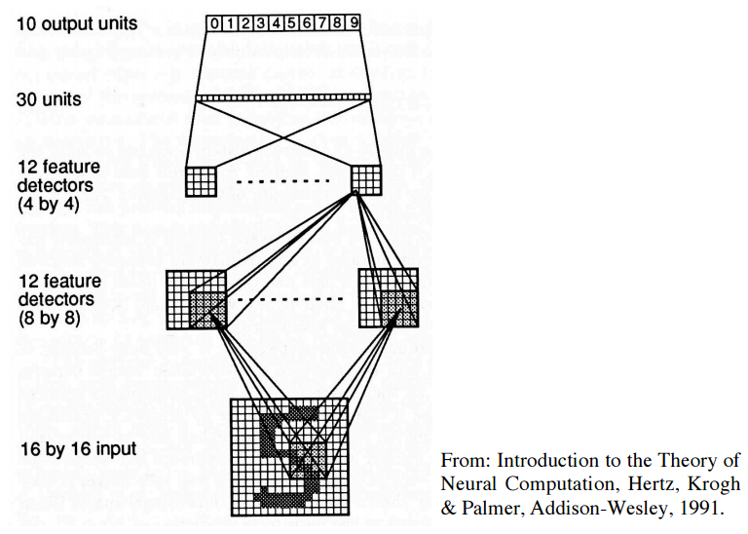
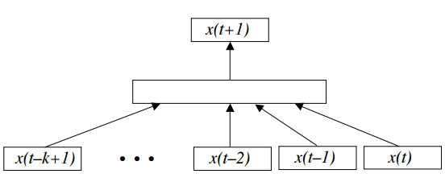
Applications of Feed-Forward Neural Net
Time Series Prediction (Stocks, Weather, etc.)
Pattern Recognition (Digit/handwriting recognition)

Slide 11
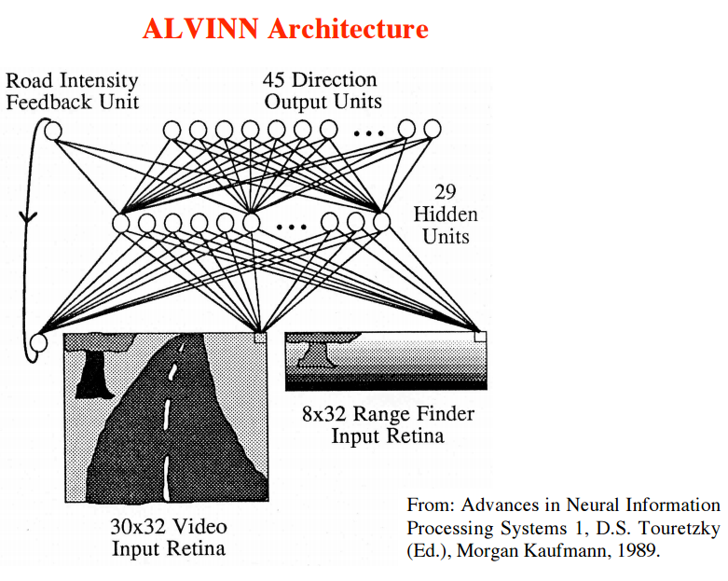
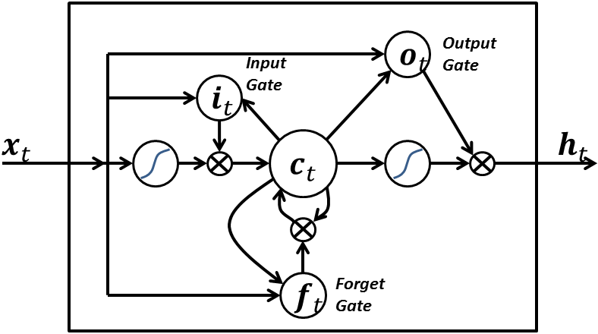
Advanced Applications (non-feed-forward)
Self-Driving Cars (ALVINN)
Long Short-Term Memory

